Slide 1

Decision Support Systems
and Business Intelligence
Chapter Two - Decision Making, Systems, Modeling, and Support

Slide 2
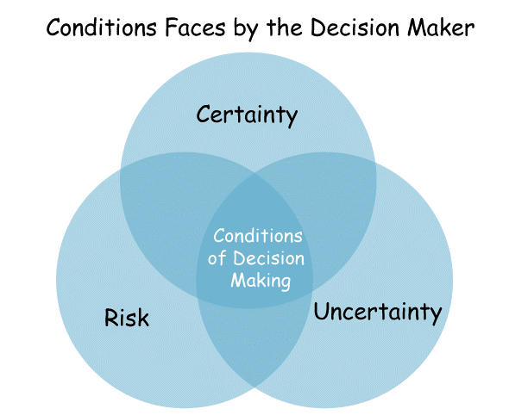
Decision Making: Introduction and Definitions
Decision making
The action of selecting among alternatives
Decision making is the process of making choices by identifying a decision, gathering information, and assessing alternative resolutions

Slide 3
Decision Making: Introduction and Definitions
Characteristics of decision making
Groupthink
Decision makers are interested in evaluating what‐if scenarios
Experimentation with the real system may result in failure
Experimentation with the real system is possible only for one set of conditions at a time and can be disastrous
Changes in the decision making environment may occur continuously, leading to invalidating assumptions about the situation

Slide 4

Decision Making: Introduction and Definitions
Characteristics of decision making
Changes in the decision making environment may affect decision quality by imposing time pressure on the decision maker
Collecting information and analyzing a problem takes time and can be expensive. It is difficult to determine when to stop and make a decision
There may not be sufficient information to make an intelligent decision
Information overload

Slide 5
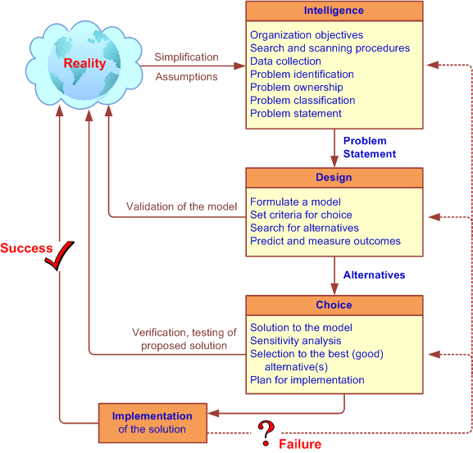
Simon’s Decision-Making Process

Slide 6
Phases of the Decision‐Making Process
Intelligence phase
The initial phase of problem definition in decision making
Design phase
The second decision‐making phase, which involves finding possible alternatives in decision making and assessing their contributions

Slide 7
Phases of the Decision‐Making Process
Choice phase
The third phase in decision making, in which an alternative is selected
Implementation phase
The fourth decision‐making phase, involving actually putting a recommended solution to work

Slide 8
Decision Making: The Intelligence Phase
Problem (or opportunity) identification: some issues that may arise during data collection
Data are not available
Obtaining data may be expensive
Data may not be accurate or precise enough
Data estimation is often subjective
Data may be insecure
Important data that influence the results may be I information overload
Outcomes (or results) may occur over an extended period
If future data is not consistent with historical data, the nature of the change has to be predicted and included in the analysis

Slide 9
Decision Making: The Intelligence Phase
Problem classification
The conceptualization of a problem in an attempt to place it in a definable category, possibly leading to a standard solution approach
Problem decomposition
Dividing complex problems into simpler subproblems may help in solving the complex problem
Problem ownership
The jurisdiction (authority) to solve a problem

Slide 10
Decision Making: The Design Phase
The design phase involves finding or developing and analyzing possible courses of action
Understanding the problem
Testing solutions for feasibility
A model of the decision‐making problem is constructed, tested, and validated

Slide 11
Decision Making: The Design Phase
The design phase involves finding or developing and analyzing possible courses of action
Modeling involves conceptualizing a problem and abstracting it to quantitative and/or qualitative form
Models have:
Decision variables
Principle of choice

Slide 12
Decision Making: The Design Phase
Decision variables
A variable in a model that can be changed and manipulated by the decision maker. Decision variables correspond to the decisions to be made, such as quantity to produce, amounts of resources to allocate, and so on
Principle of choice
The criterion for making a choice among alternatives

Slide 13
Decision Making: The Design Phase
Developing (generating) alternatives
In optimization models the alternatives may be generated automatically by the model
In most MSS situations it is necessary to generate alternatives manually (a lengthy, costly process); issues such as when to stop generating alternatives are very important
The search for alternatives usually occurs after the criteria for evaluating the alternatives are determined
The outcome of every proposed alternative must be established
Notes:
Management support systems

Slide 14
Decision Making: The Design Phase
Measuring outcomes
The value of an alternative is evaluated in terms of goal attainment
Risk
One important task of a decision maker is to attribute a level of risk to the outcome associated with each potential alternative being considered

Slide 15
Decision Making: The Design Phase
Scenario
A statement of assumptions about the operating environment of a particular system at a given time; a narrative description of the decision‐ situation setting
Scenarios are especially helpful in simulations and what‐if analyses

Slide 16
Decision Making: The Design Phase
Scenario
Scenarios play an important role in MSS because they:
• Help identify opportunities and problem areas
• Provide flexibility in planning
• Identify the leading edges of changes that management should monitor
• Help validate major modeling assumptions
• Allow the decision maker to explore the behavior of a system through a model
• Help to check the sensitivity of proposed solutions to changes in the environment

Slide 17
Decision Making: The Design Phase
Scenario
Possible scenarios
• The worst possible scenario
• The best possible scenario
• The most likely scenario
• The average scenario

Slide 18
Decision Making: The Choice Phase
Sensitivity Analysis
A study of the effect of a change in one or more input variables on a proposed solution
What‐if analysis
A process that involves asking a computer what the effect of changing some of the input data or parameters would be

Slide 19
Decision Making: The Implementation Phase
Generic implementation issues important in dealing with MSS include:
Resistance to change
Degree of support of top management
User training

Slide 20
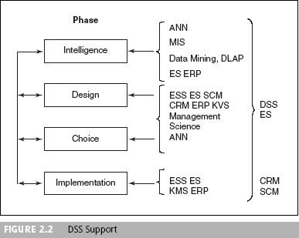
DSS Support

Slide 21
Specific uses for DSSs in business
Medicine: When a DSS is used in medicine, it is known as a clinical DSS. The technology can be used in a variety of ways, such as maintaining research information about chemotherapy protocols, preventive and follow-up care, and monitoring medication orders. DSSs are also used with medical diagnosis software.
Weather forecasting: Some states have used DSSs to provide information about potential hazards, such as floods. The system includes real-time weather conditions and may include information, both current and historical, about floodplain boundaries and county flood data.
Real estate: Real estate companies often use DSSs to manage data on comparable home prices and acreage.
Education: Universities and colleges rely on DSSs to know how many students are currently enrolled. This helps them predict how many students will register for particular courses or whether the student population is sufficient to meet the university’s costs.

Slide 22
DSS Modeling
Key element in DSS
Many classes of models
Specialized techniques for each model
Allows for rapid examination of alternative solutions
Multiple models often included in a DSS
Model is a representation of an actual system.
Models embody system characteristics that are important to the model’s users.
At the same time, models simplify reality by eliminating other characteristics that are not important for their purpose.
The central idea of a model is that important relationships that apply to the system being modeled also apply to the model.

Slide 23
DSS Modeling
The benefits of models
Model manipulation is much easier than manipulating a real system
Models enable the compression of time
The cost of modeling analysis is much lower
The cost of making mistakes during a trial‐and‐ error experiment is much lower when models are used than with real systems

Slide 24
Introduction to Decision Analysis
The field of decision analysis provides a framework for making important decisions.
Decision analysis allows us to select a decision from a set of possible decision alternatives when uncertainties regarding the future exist.
The goal is to optimize the resulting payoff in terms of a decision criterion.

Slide 25
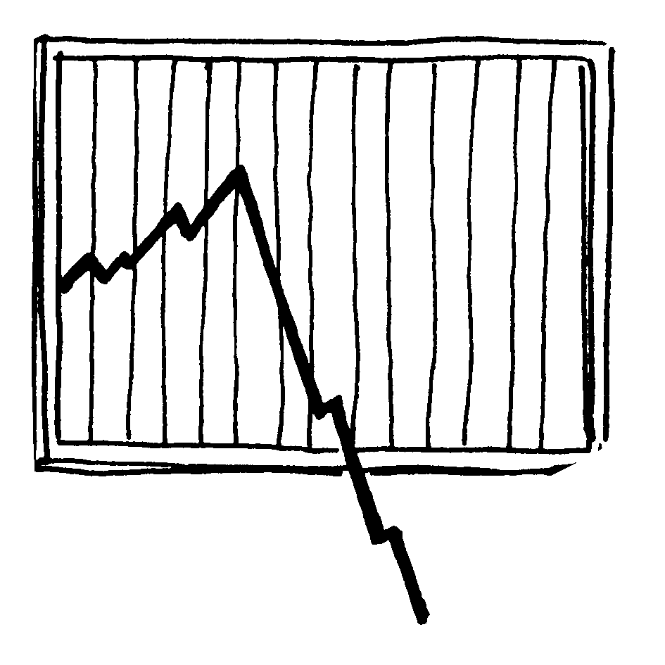
Introduction to Decision Analysis
Maximizing expected profit is a common criterion when probabilities can be assessed.
Maximizing the decision maker’s utility function is the mechanism used when risk is factored into the decision making process.

Slide 26
Decision theory
Decision theory is a general approach to decision making. It is very useful for a decision maker who must choose from a list of a alternative. Knowing that one of a number of possible future states of nature will occur and that this will have an impact on the payoff realized by a particular alternative.

Slide 27
Glossary
Payoff: a table that shows the payoff for each alternative for each state of nature.
Risk: A decision problem in which the state of nature have probability associated which their occurrence.
Uncertainty: Refers to a decision problem in which probabilities of occurrence for the various states of nature one unknown.
Decision tree: A schematic representation of a decision problem that involves the use of branches and nodes.

Slide 28
Decision theory
1. Decision making
A. Under certainty.
B. Under complete uncertainty.
C. Under risk.
2. Decision tree
A. Expected monetary value model .
B. Expected net present value model.

Slide 29
Modeling and Decision Making - Under Certainty, Uncertainty, and Risk
Certainty
Assume complete knowledge
All potential outcomes are known
May yield optimal solution
Uncertainty
Several outcomes for each decision
Probability of each outcome is unknown
Knowledge would lead to less uncertainty
Risk analysis (probabilistic decision making)
Probability of each of several outcomes occurring
Level of uncertainty => Risk (expected value)

Slide 30
Decision theory
Decision theory problems are characterized by the following :
1. A list of alternatives .
2. A list of possible future states of natures .
3. Payoff associated with each alternative / state of nature combination .
4. An assessment of the degree of certainty of possible future events.
5. A decision criterion .

Slide 31
Modeling and Decision Making: Under Certainty, Uncertainty, and Risk
The Zones of Decision Making
Increasing Knowledge
Complete Knowledge certainty
Risk
Ignorance total uncertainty
Decreasing Knowledge

Slide 32
Decision Tables
Decision tables are a convenient way to organize information in a systematic manner. It can be done in a spreadsheet and thus looks like a table.
Multiple criteria decision analysis
Features include:
Decision variables (alternatives)
Uncontrollable variables
Result variables
Applies principles of certainty, uncertainty, and risk

Slide 33
Example
An investment company is considering investing in one of three alternatives:
bonds, stocks, or certificates of deposit (CDs). The company is interested in one goal: maximizing the yield on the investment after one year.
If it were interested in other goals, such as safety or liquidity, the problem would be classified as one of multi-criteria decision analysis.
The yield depends on the state of the economy sometime in the future (called the state of nature), which can be in solid growth, stagnation, or inflation. Experts estimated the following annual yields:
If there is solid growth in the economy, bonds will yield 12%, stocks 15%, and time deposits 6.5%.
If stagnation prevails, bonds will yield 6%, stocks 3%, and time deposits 6.5%.
If inflation prevails, bonds will yield 3%, stocks will bring a loss of 2%, and time deposits will yield 6.5%.

Slide 34
Investment Problem Decision Table Model
 | State of Nature (Uncontrollable Variables)
Alternative | Solid Growth | Stagnation | Inflation
Bonds (Obligat.) | 12.0 % | 6.0 % | 3.0 %
Stocks (Actiuni) | 15.0 % | 3.0 % | -2.0 %
CDs (Cert. Dep.) | 6.5 % | 6.5 % | 6.5 %

Slide 35
Treatment the risk
The most common method for solving this risk analysis problem is to select the alternative with the greatest expected value.
Assume that the experts estimate the chance of solid growth at 50%, the chance of stagnation at 30%, and the chance of inflation at 20%.
The decision table is then rewritten with the known probabilities (see next table).
An expected value is computed by multiplying the results (outcomes) by their respective probabilities and adding them. For example, investing in bonds yields an expected return of 12(0.5)+6(0.3)+3(0.2)=8.4%

Slide 36
Decision Under Risk and its Solution
Alternative | Solid Growth 50.0 % | Stagnation 30.0 % | Inflation 20.0 % | Expected Value
Bonds | 12.0 % | 6.0 % | 3.0 % | 8.4 %
Stocks | 15.0 % | 3.0 % | -2.0 % | 8.0 %
CDs | 6.5 % | 6.5 % | 6.5 % | 6.5 %

Slide 37
A simplified investment case of multiple goals (a decision situation in which alternative are evaluated with several, sometimes conflicting, goal) is shown in next table
Alternative | Yield | Safety | Liquidity
Bonds | 8.4 % | High | High
Stocks | 8.0 % | Low | High
CDs | 6.5 % | Very High | High
The three goals (criteria) are yield, safety, liquidity. This situation is under assumed certainty: that is, only one possible consequence is projected for each alternative; the more complex cases of risk or uncertainty could be considered. Some of the results are qualitative (e.g. low, high rather than numeric

Slide 38
The payoff table
A payoff table is a device a decision maker can use to summarize and organize information relevant to particular decision .
A payoff table includes :
1. A list of the alternatives .
2. The possible future state of nature .
3. The payoffs associated with each of the alternative/ state of nature combinations .
4. If probabilities for the state of nature are available, these can also be listed .

Slide 39
Payoff Table Analysis
Payoff Tables
Payoff table analysis can be applied when:
There is a finite set of discrete decision alternatives.
The outcome of a decision is a function of a single future event.
In a Payoff table -
The rows correspond to the possible decision alternatives.
The columns correspond to the possible future events.
Events (states of nature) are mutually exclusive and collectively exhaustive.
The table entries are the payoffs.

Slide 40
Table : General format of a decision table .
State of nature
S1
S2
S3
A
V11
V12
V13
alternatives
B
V21
V22
V23
C
V31
V32
V33
Where :
A , B , C = alternatives.
Sn = the n th state of nature.
Vij = the value of payoff that will be realized if alternative X is chosen and event j occurs.

Slide 41
Example :-
Suppose an investor must decide on an alternative to invest his/ her money to maximize profit or revenue. He /she has the following alternative :
A: bonds
B: socks
C: deposits
suppose in the case of investment the profitability influences with economic development. Suppose that the investor views the possibilities as :
Economic growth.
Economic decline.
3. Economic inflation.
Suppose the payoff are
alternatives
State of natures.
1
2
3
A
12
6
-3
Initiate payoff tableau
B
10
7
-2
C
10
10
10

Slide 42
Investment payoff tableau
State of nature
Eco. S1 growth
Eco. S2 decline
Eco. S3 inflation
alternatives
Bonds A
12
6
-3
Bonds B
10
7
-2
Bonds C
10
10
10
Note :- If the investor choose A – S1 , that is, he /she realizes a profit of $1200 as a returns on bonds.
If the investor choose A – S3 that is, he /she realize a losses of $300 .

Slide 43
1. Decision making under certainty.
The simplest of all circumstances occurs when decision making takes place in an environment of complete certainty .
In our case the investor should bonds because it has the highest estimated payoff of 12 in that column.

Slide 44
2. Decision making under complete uncertainty.
Under complete uncertainty, the decision maker is ether unable to estimate the probabilities for the occurrence of the different state of nature, or else he/ she lacks confidence in available estimate of probabilities.
That is, probabilities are not included in the analysis.
To solve a problem, we shall consider 5 approaches to decision making under complete uncertainty:
1. Maxi Max .
2. Maxi Min .
3. Equally likely .
4. Criterion of realism.
5. Min Max regret .

Slide 45
1. Maxi Max approach :-
It is an optimistic view point.
It’s procedures are simple : choose the best payoff for each alternative and then choose the maximum one among them .
Consider the example :
S1
S2
S3
Best payoff
A
4
16
12
16
maximum
B
6
6
10
10
C
-1
4
15
15

Slide 46
2. Maxi Min approach :-
It is an pessimistic view point.
It’s procedures are simple : choose( worst ) payoff for each alternative and then choose the maximum one among them .
Consider the example :
Minimum
Minimum
S1
S2
S3
Worst payoff
A
4
16
12
4
maximum
B
5
6
10
5
C
-1
4
15
-1

Slide 47
3. Equally likely approach:
The decision maker should not focus on either high or low payoffs, but should treat all payoff ( actually, all states of nature ) as of they were equally likely averaging row payoffs accomplishes this.
Consider the example :
S1
S2
S3
Expected payoff
A
4
16
12
(4 + 16 + 12)/ 3
= 12.40
maximum
B
5
6
10
(5 + 6 + 10)/ 3
= 7.00
C
-1
4
15
(-1 + 4 + 15)/3
= 6.30

Slide 48
4. Criterion of realism :
Many people views maxi min criterion as pessimistic because they believe that the decision maker must assume that the worst will occur.
The opposite views for maxi max, they are optimistic.
Criterion of realize combine the tow opposite views points.
So we need to know the percent of optimistic and the percent of pessimistic.
Suppose that:
60% optimistic.
40% pessimistic.
Expected value = worst payoff ( % pessimistic ) + best payoff ( % optimistic )

Slide 49
Consider the example :
S1
S2
S3
Worst payoff Best payoff
A
4
16
12
4 16
B
5
6
10
5 10
C
-1
4
15
-1 15
A = 4 ( .40 ) + 16 ( .60 ) = 11.2 maximum
B = 5 ( .40 ) + 10 ( .60 ) = 8.0
C = -1 ( .40 ) + 15 ( .60 ) = 8.6

Slide 50
5. Mini max regret approach :
In order to use this approach, it is necessary to develop an opportunity loss table.
The opportunity loss reflects the difference between each payoff and the best payoff in the column ( given the state of nature ) .
Hence, opportunity loss amounts are found by identifying the best payoff in a column and then subtracting each of the other values in the column from that payoff.
Go to the example

Slide 51
Opportunity loss table for investment problem.
Original payoff table :
Opportunity loss table :
S1
S2
S3
A
4
16
12
B
5
6
10
C
-1
4
15
Maximum loss
S1
S2
S3
S1
S2
S3
A
5 – 4 = 1
16 – 16 = 0
15 – 12 = 3
A
1
0
3
3
B
5 – 5 = 0
16 –6 = 10
15 – 10 = 5
B
0
10
6
10
C
5 – -1 = 6
16 – 4= 12
15 – 15 = 0
C
6
12
0
12
Minimum

Slide 52
3. Decision making under risk .
The essential difference between decision making under complete uncertainty and decision making partial uncertainty ( risk ) is the presence of probabilities.
Under risk the manager know the probabilities for the occurrence of various state of natures.
1. The probabilities may be subjective estimates from manager, or
2. From experts in a particular field , or .
3. They may reflect historical frequencies .

Slide 53
The model to be used for solving decision making problems under risk. Is as follows :
Expected monetary value :
Emvi = PJVIJ
Where :
Emvi = The expected monetary value for the i th alternative .
Pj = The probability of the j th state of nature .
Vij = The estimated payoff for alternative i under state of nature j .
Go to example
K
M
i = 1

Slide 54
Example : decision under risk
S1
S2
S3
A
4
16
12
B
5
6
10
C
-1
4
15
Probability .2 .5 .3 = 1.0
Maximum
EmvA = .2 ( 4 ) + .5 ( 16 ) + .3 ( 12 ) = 12.40
EmvB = .2 ( 5 ) + .5 (6 ) + .3 ( 15 ) = 7.00
EmvC = .2 ( -1 ) + .5 ( 4 ) + .3 ( 15 ) = 6.30
If you want to compute Emvi for expected opportunity loss
Co to the example

Slide 55
Example :
Investment problem, opportunity losses .
S1
S2
S3
A
1
0
3
B
0
10
5
C
6
12
0
Probabilities .2 .5 .3
Minimum
EolA = .2 ( 1 ) + .5 (0 ) + .3 ( 3 ) = 1.1
EolB = .2 ( 0 ) + .5 (10 ) + .3 ( 5 ) = 6.5
EolC = .2 ( 6 ) + .5 (12 ) + .3 ( 0 ) = 7.2
Note :- Eol , expected opportunity loss

Slide 56
Decision tree
Sometimes are used by decision makers to obtain a visual picture of decision alternatives and their possible consequences.
A tree is composed of
1. Squares decision point
2. Circles chance events
3. Lines state of natures
See the figure :
State of nature
Alternative
Decision point

Slide 57
Decision Trees
The Payoff Table approach is useful for a non-sequential or single stage.
Many real-world decision problems consists of a sequence of dependent decisions.
Decision Trees are useful in analyzing multi-stage decision processes.
Decision trees can be used to make decisions under different levels of certainty, uncertainty, and risk. Here are examples illustrating decision-making scenarios under each condition:

Slide 58
Decision Trees symbols
A decision tree includes the following symbols:
Alternative branches: Alternative branches are two lines that branch out from one decision on your decision tree. These branches show two outcomes or decisions that stem from the initial decision on your tree.
Decision nodes: Decision nodes are squares and represent a decision being made on your tree. Every decision tree starts with a decision node.
Chance nodes: Chance nodes are circles that show multiple possible outcomes.
End nodes: End nodes are triangles that show a final outcome.
A decision tree analysis combines these symbols with notes explaining your decisions and outcomes, and any relevant values to explain your profits or losses. You can manually draw your decision tree or use a flowchart tool to map out your tree digitally.
Decision trees can be used to make decisions under different levels of certainty, uncertainty, and risk. Here are examples illustrating decision-making scenarios under each condition:

Slide 59
Decision Trees- Certainty
Example: Buying a Car
Let's say you are planning to buy a car, and you have clear criteria to consider, such as price, fuel efficiency, safety ratings, and brand reputation. You create a decision tree to guide your purchase:
Criteria:
Price: Budget < $20,000?
Yes: Proceed to Step 2.
No: Do not buy.
Fuel Efficiency: Mileage > 30 MPG?
Yes: Proceed to Step 3.
No: Do not buy.
Safety Ratings: Rating > 4 stars?
Yes: Buy.
No: Do not buy.

Slide 60
Decision Trees- Certainty
Example: Buying a Car
Options within Budget:
Brand Reputation:
Good: Buy.
Not Good: Do not buy.
Options with Good Fuel Efficiency:
Safety Ratings:
Rating > 3 stars: Buy.
Rating <= 3 stars: Do not buy.
In this scenario, all factors are known, and the decision tree helps you make a clear decision based on predetermined criteria.

Slide 61
Decision Trees- Certainty
Price < $20,000?
Yes
Fuel Efficiency > 30 MPG?
No
Do not buy
Do not buy
No
Yes
Safety Ratings > 4 stars?
yes
Do not buy
no
Buy

Slide 62
Decision Trees- Uncertainty
Example: Investment Decision
Imagine you're considering investing in a stock, and the outcome of the investment depends on multiple uncertain factors such as market conditions, company performance, and geopolitical events. You create a decision tree to model the investment decision:

Slide 63
Decision Trees- Uncertainty
Market Conditions:
Bullish:
Company Performance:
Positive: Invest.
Negative: Do not invest.
Bearish:
Geopolitical Stability:
Stable: Invest with caution.
Unstable: Do not invest.
Investment Outcome:
Positive: Gain profit.
Negative: Incur losses.
In this scenario, the decision tree incorporates uncertainty about market conditions and other factors, guiding the investment decision based on potential outcomes.

Slide 64
Decision Trees- Uncertainty
Market Conditions
Bullish
Bearish
Unstable
Positive
Invest
Stable
Do not invest
Invest
Do not invest
Negative

Slide 65
Decision Trees- Risk
Example :your are planning to Build new scheduling app or Upgrade existing scheduling app or Build team productivity app.
Decision nodes from this example:
Build new scheduling app: $50K
Upgrade existing scheduling app: $25K
Build team productivity app: $75K

Slide 66
Decision Trees- Risk
Chance nodes from this example:
Large and small revenue for decision one: 40 and 55%
Large and small revenue for decision two: 60 and 38%
Large and small revenue for decision three: 55 and 45%
End nodes from this example:
Potential profits for decision one: $200K or $150K
Potential profits for decision two: $100K or $80K
Potential profits for decision three: $250K or $200K
Although building a new team productivity app would cost the most money for the team, the decision tree analysis shows that this project would also result in the most expected value for the company.

Slide 67
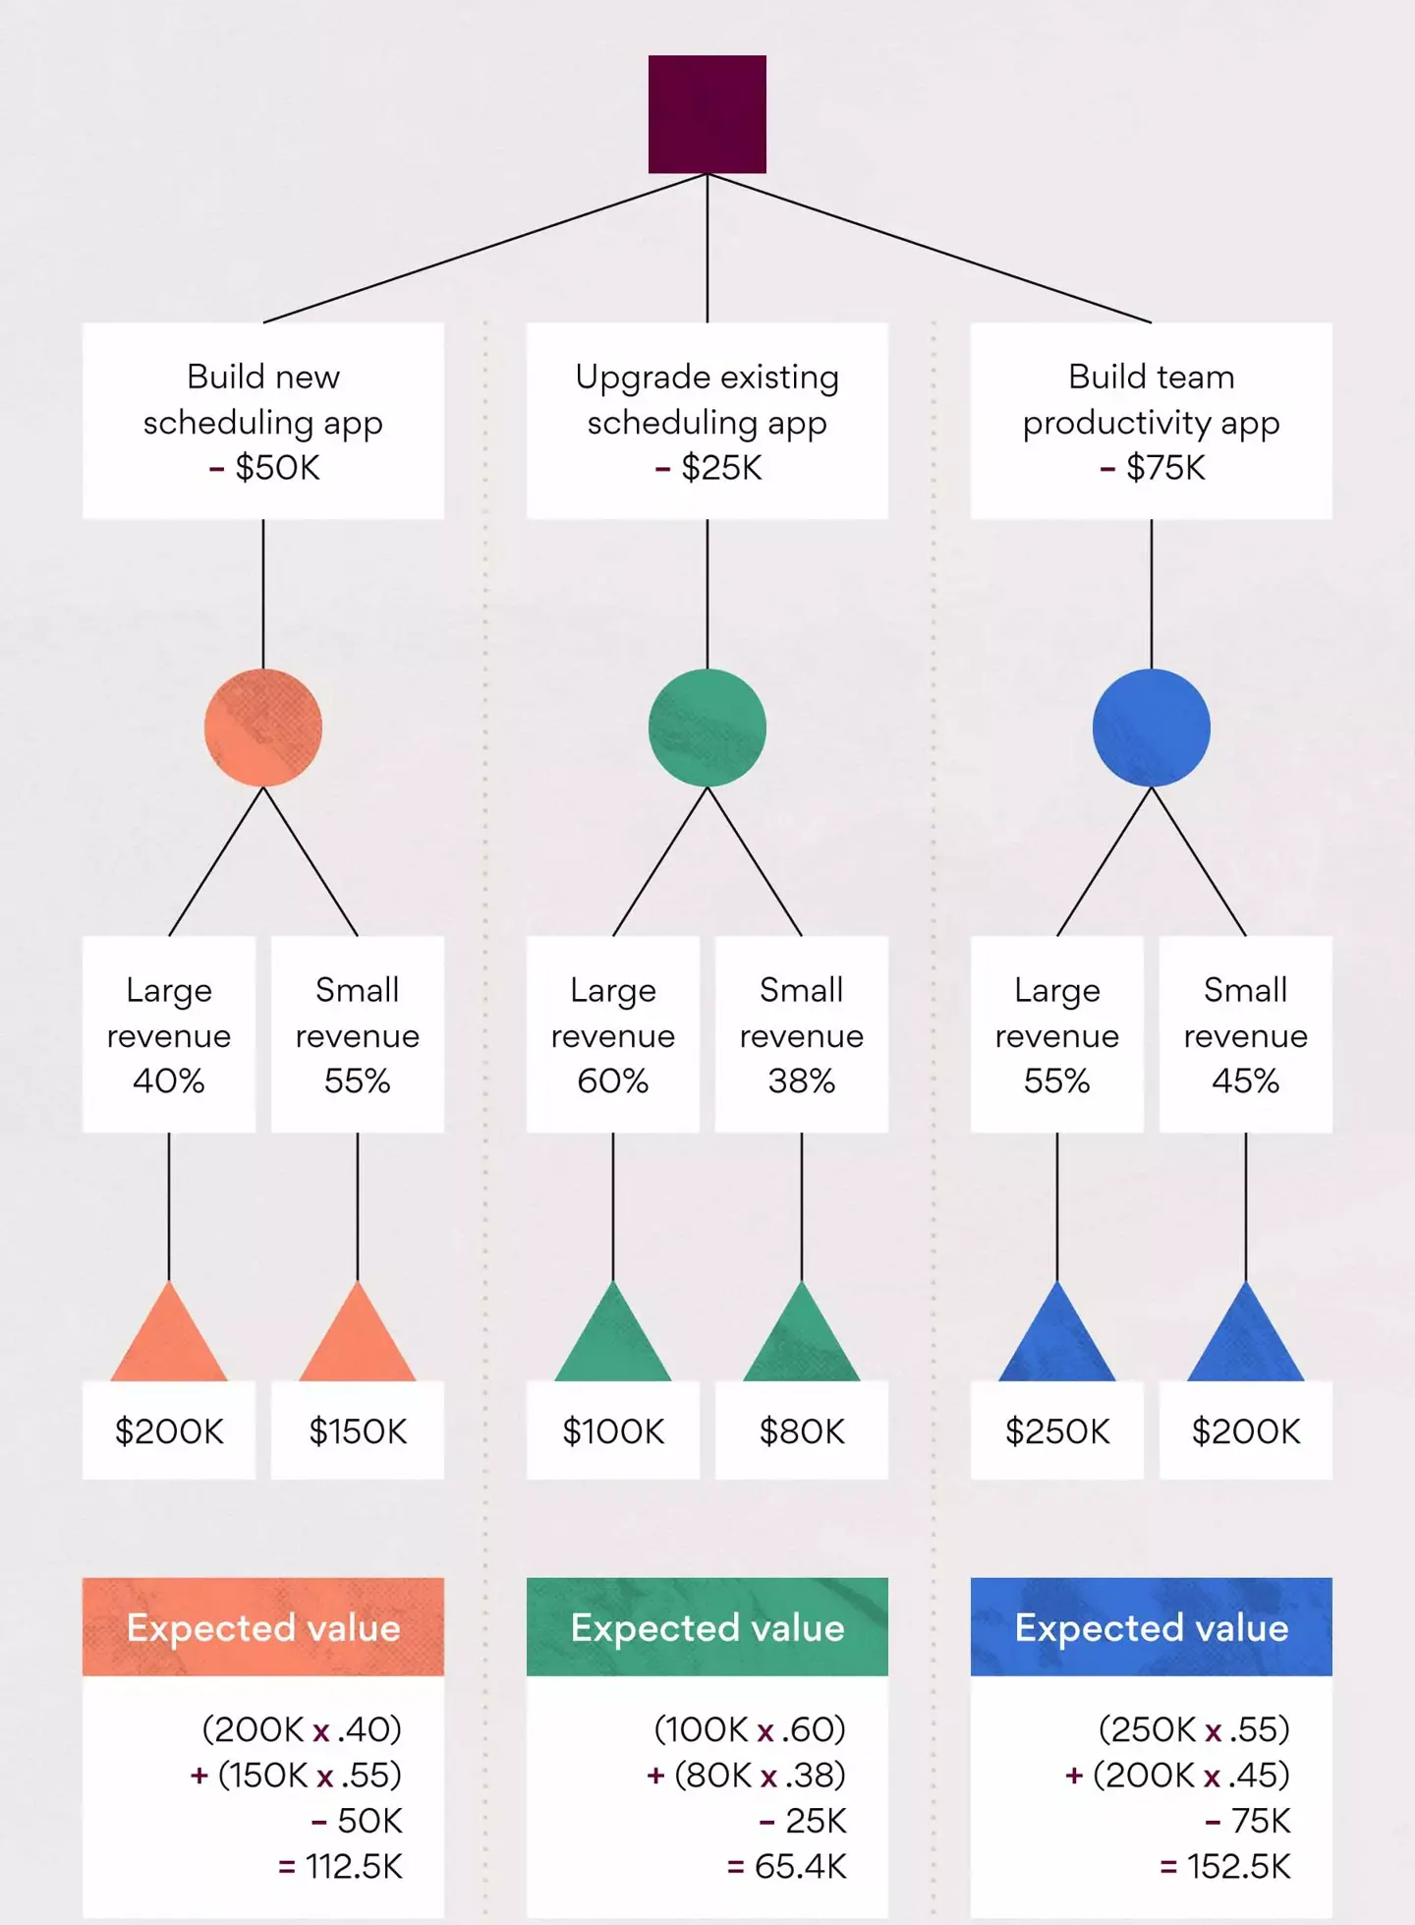
Decision Trees- Risk

